Slide 1
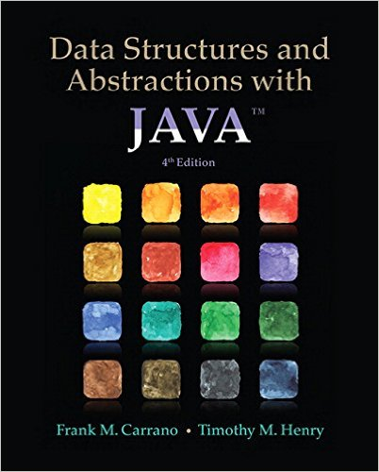
Lecture 2
Chapter 2 : Bag Implementations that Use Arrays

Slide 2
More about Generics

Slide 3
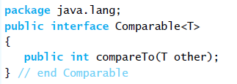
The Interface Comparable
By invoking compareTo, you compare two objects of the class T.
Consider the method compareTo for class String
  if s and t are strings, s.compareTo(t) is
    Negative if s comes before t
    Zero if s and t are equal
    Positive if s comes after t

Slide 4
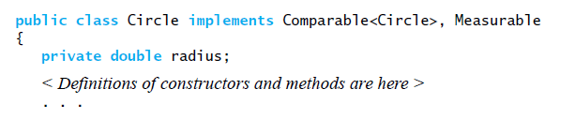
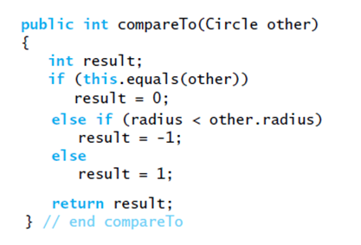
The Interface Comparable
Create a class Circle,define compareTo
public int compareTo(Circle other)
{
return this.radius – other.radius;
}
Better solution

Slide 5
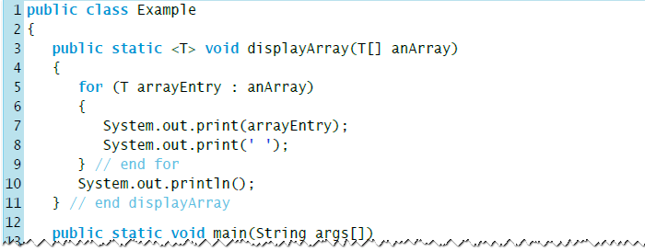
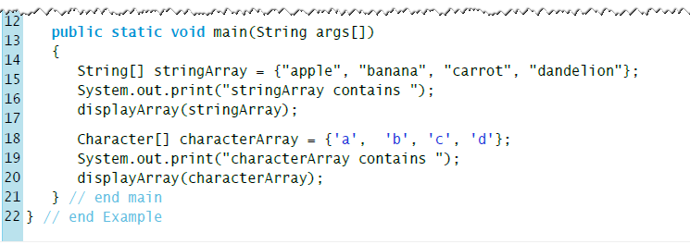
Generic Methods

Slide 6
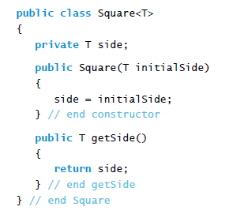
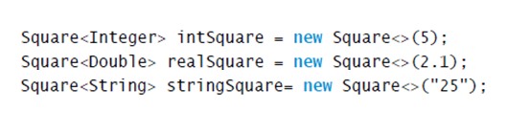
Bounded Type Parameters - 1
Consider this simple class of squares:
Note the different types of square objects possible:
This flexibility is a problem!

Slide 7
Bounded Type Parameters - 1
We want to be able to impose a restriction by making T representing a class that is derived from Number, the superclass of classes Byte, Double, Float, Integer, Long and Short.
Thus we bound T by writing T extends Number in the Square header:
public class Square<T extends Number>

Slide 8
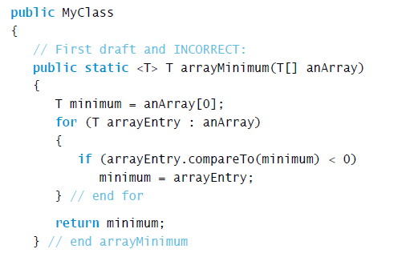
Bounded Type Parameters - 2
Imagine that we want to write a static method that returns the smallest object in an array. The objects in the array might be any objects that can be compared.
Suppose that we wrote our method as shown:

Slide 9
Wildcards
Question mark, ?, is used to represent an unknown class type
  Referred to as a wildcard

Slide 10
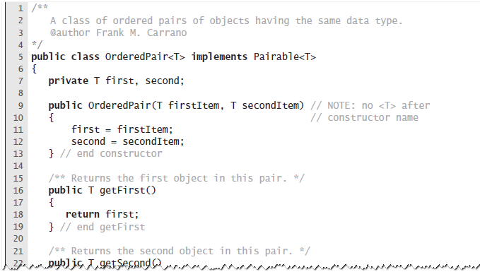
Wildcards – example 1
Consider following method and objects:
We can create a reference variable:
OrderedPair<?> aPair;
  We can now assign:
aPair = new OrderedPair<>(“apple”, “banana”);
  or
aPair = new OrderedPair<>(1,2);
  or a pair of objects of any other class

Slide 11
Bounded Wildcards
Instead of comparing an object T only with other objects of T, we can allow comparisons to objects of a superclass of T:
  The wildcard ? represents any class type, but the notation ? Super T means any superclass of T
public static <T extends Comparable<? super T>> void arrayMinumum(T[] a, int n)

Slide 12
Type Parameter Names
By convention:
  type parameter names are single, uppercase letters.
  this makes it easier for programmers to spot the difference between a type variable and a class or interface name.
    The compiler can tell this from the context, so this is just for the benefit of programmers.
  the most commonly used type parameter names are:
    E - Element (used extensively by the Java Collections Framework)
    K – Key
    V - Value
    N - Number
    T - Type
    S,U - 2nd, 3rd types

Slide 13
Bag Implementations That Use Arrays
Chapter 2

Slide 14
Contents
Using a Fixed-Size Array to Implement the ADT Bag
  An Analogy
  A Group of Core Methods
  Implementing the Core Methods
  Testing the Core Methods
  Implementing More Methods
  Methods That Remove Entries

Slide 15
Contents
Using Array Resizing to Implement the ADT Bag
  Resizing an Array
  A New Implementation of a Bag
The Pros and Cons of Using an Array to Implement the ADT Bag

Slide 16
Objectives
Implement ADT bag using
  a fixed-size array or
  an array that expanded dynamically
Discuss advantages and disadvantages of implementations presented

Slide 17
Implement with Fixed Size Array
Define methods specified by previous interface BagInterface
Consider use of fixed size array
  Not unlike a classroom with exactly 40 desks
  Numbered from 0 to 39

Slide 18
Adding, Removing Students
Adding
  Arbitrarily specify consecutively numbered desks be occupied
  When desk #39 occupied, room is full
Removing
  What to do when someone in middle of sequence is removed?
  Move last person there or shift everyone?

Slide 19
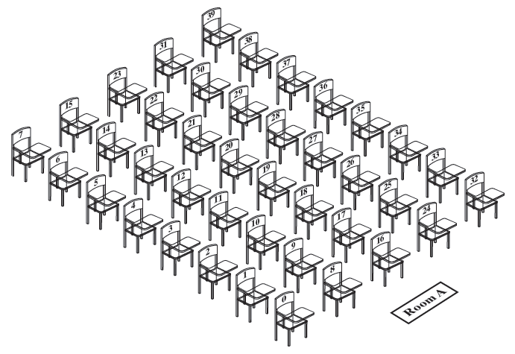
Figure 2-1 A classroom that contains desks in fixed positions

Slide 20
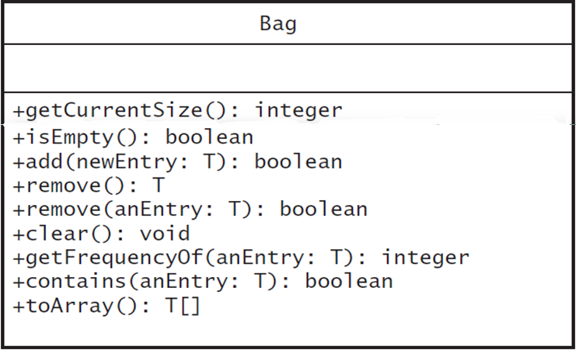
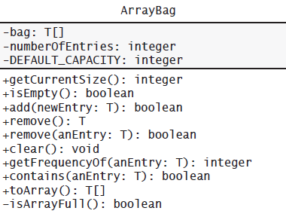
UML diagram for the class ArrayBag
UML diagram for the interface Bag

Slide 21
Group of Core Methods
Do not attempt to define entire class, then test
Instead, identify group of core methods
  Define
  Test
  Then finish rest of class
Note outline, Listing 2-1

Slide 22
Design Decisions
When array bag is partially full
  Which array elements should contain entries?
Options
  Start at element 0 or element 1 ?
  Require elements to be sequential?

Slide 23
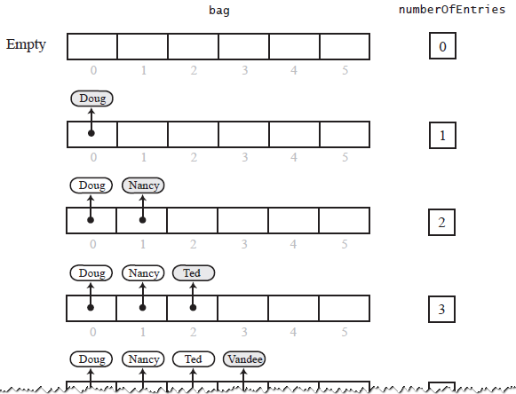
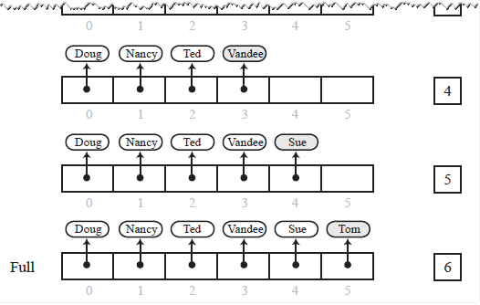
Figure 2-3 Adding entries to an array that represents a bag, whose capacity is six, until it becomes full

Slide 24
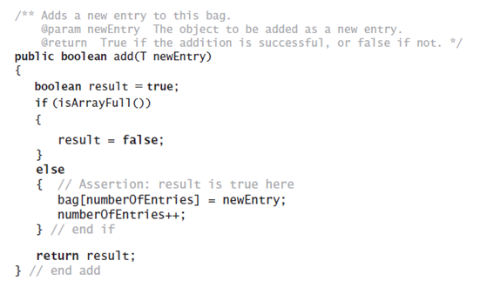
Add Method

Slide 25
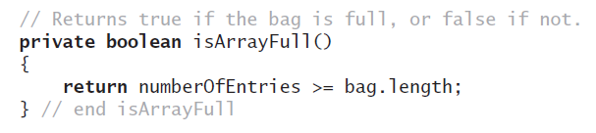
Method isArrayFull

Slide 26
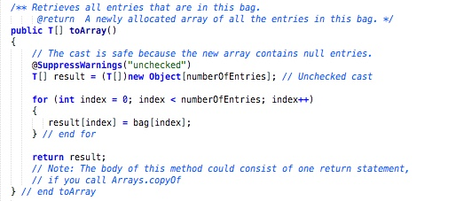
Method toArray

Slide 27
Design Decisions
Should toArray return the array bag or a copy?
  Best to return a copy … think about why.
Temporarily make stub methods for testing at this stage
View test program, Listing 2-2

Slide 28

Making the Implementation Secure
Practice fail-safe programming by including checks for anticipated errors
Validate input data and arguments to a method
refine incomplete implementation of ArrayBag to make code more secure by adding the following two data fields

Slide 29
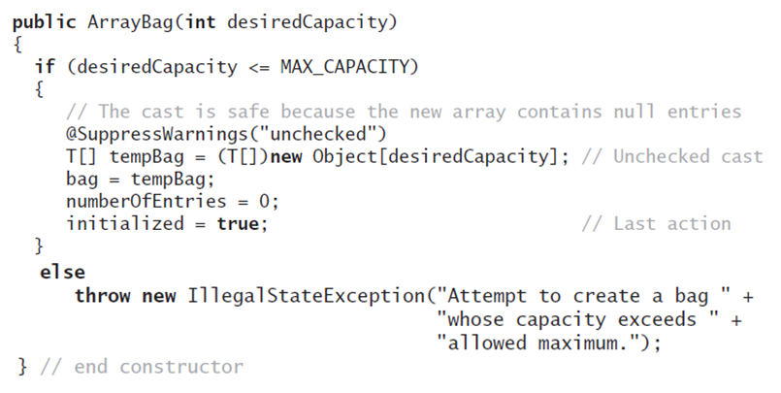
Making the Implementation Secure
Revised constructor

Slide 30
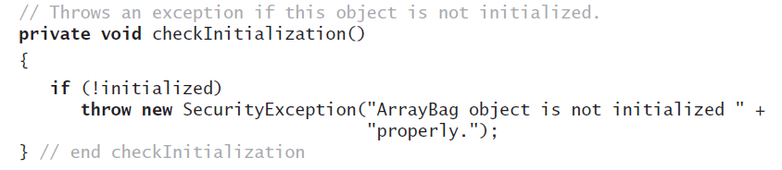
Making the Implementation Secure
Method to check initialization

Slide 31
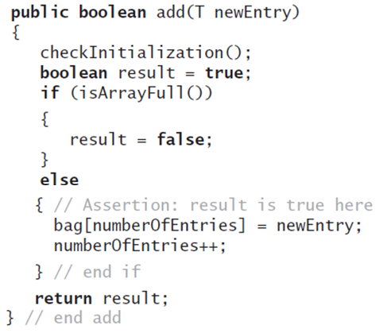
Making the Implementation Secure
Revise the method add

Slide 32
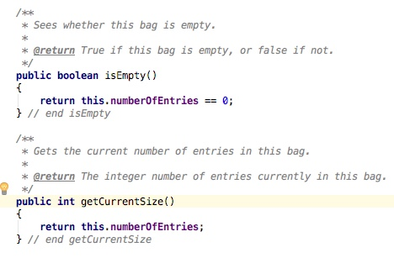
Implementing More Methods
Methods isEmpty and getCurrentSize

Slide 33
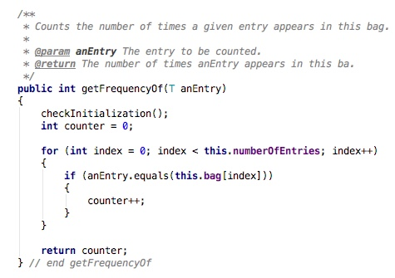
More Methods
Method getFrequencyOf

Slide 34
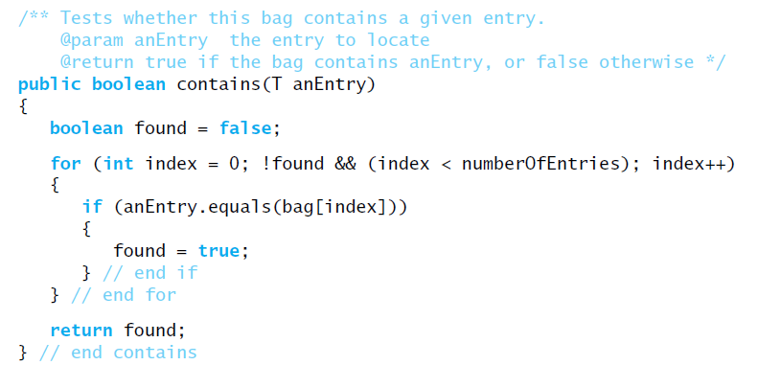
More Methods
Method contains
Stops the loop as soon as the target is found

Slide 35
Question
Method contains could call getFrequencyOf instead of executing a loop:
public boolean contains(T entry)
{
return getFrequencyOf(enEntry) > 0;
}
What is an advantage and a disadvantage of this definition as compared to the previous one?

Slide 36
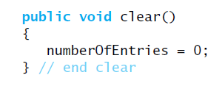
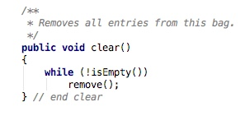
Methods That Remove Entries
Method clear()
  Remove all entries
  Another version:

Slide 37
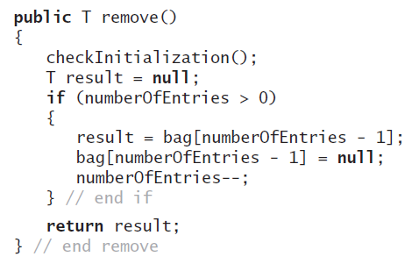
Methods That Remove Entries
Method remove()
  Remove last
  entry in bag
  Could this be more
  efficient?

Slide 38
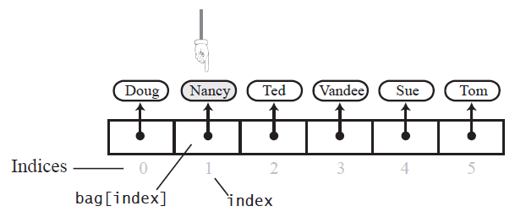
Figure 2-5 The array bag after a successful search for the string “Nancy"
Removing a Specified Entry

Slide 39
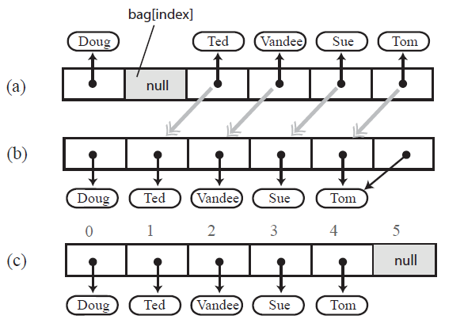
Figure 2-6
(a) A gap in the array bag after setting the entry in bag[index] to null;
(b) the array after shifting subsequent entries to avoid a gap
Removing a Specified Entry- option 1

Slide 40
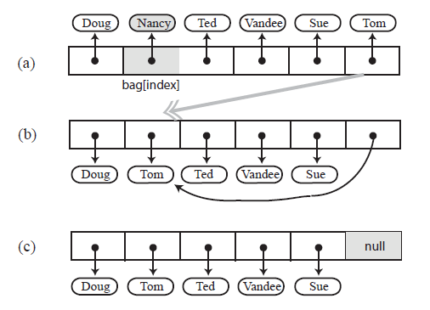
Figure 2-7 Avoiding a gap in the array while removing an entry
Removing a Specified Entry – option 2

Slide 41
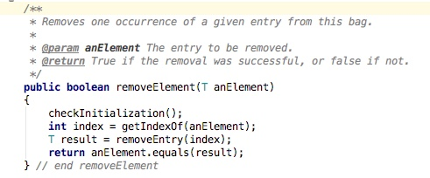
Methods That Remove Entries
Method to remove a specified entry
  Assumes presence of private getIndexOf and removeEntry methods

Slide 42
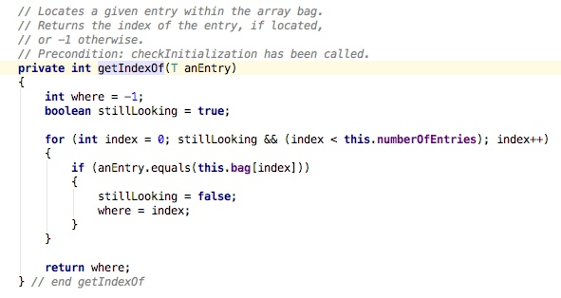
Methods That Remove Entries
Revised definition for the method getIndexOf

Slide 43
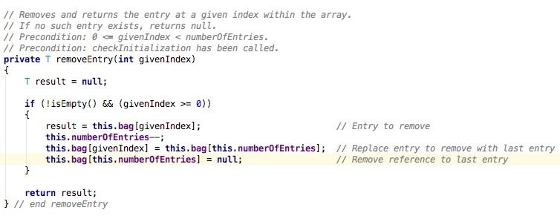
Methods That Remove Entries
The removeEntry method
Note:
- entries in no particular order
- no gaps allowed!

Slide 44
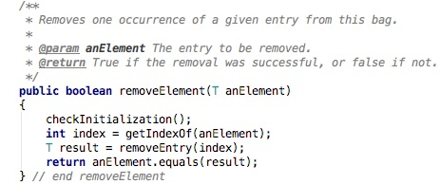
Question
Can the return statement of remove be written as follows?
  return result.equals(anEntry);
  return result != null;

Slide 45
Question
If a bag aBag contains the strings A, A, B, A, C why does aBag.remove(“B”); change the contents to A, A, C, A ?

Slide 46
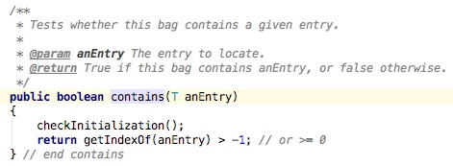
contains method revised

Slide 47
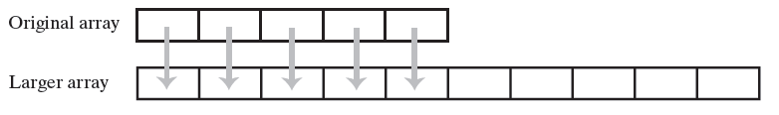
Resizing Array
Need to accommodate more elements than originally specified for bag
Figure 2-8 Resizing an array copies its contents
to a larger second array

Slide 48
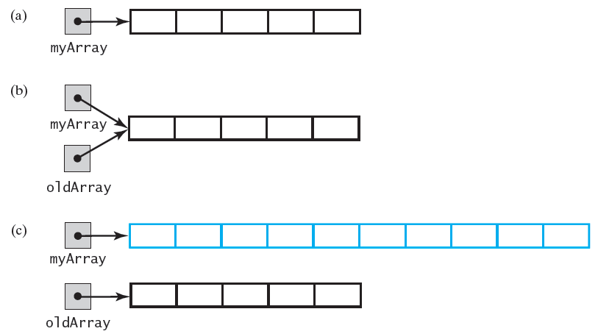
Figure 2-9
An array;
two references to the same array;
the original array variable now references a new, larger array;

Slide 49
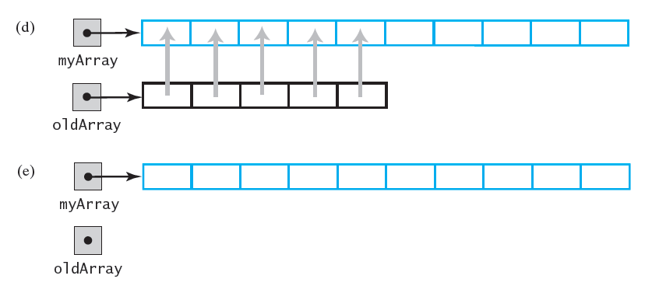
Figure 2-9
(d) the entries in the original array are copied to the new array;
(e) the original array is discarded

Slide 50
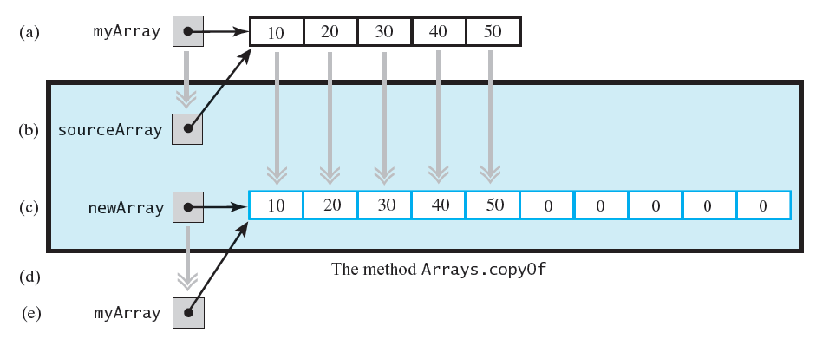
FIGURE 2-10 The effect of the statement: myArray = Arrays.copyOf(myArray, 2 * myArray.length);
(a) the argument array;
(b) the parameter that references the argument array;
(c) a new, larger array that gets the contents of the argument array;
(d) the return value that references the new array;
(e) the argument variable is assigned the return value

Slide 51
A New Implementation of a Bag
Change name of ArrayBag class to ResizableArrayBag, to distinguish between implementations.
Remove modifier final from declaration of array bag to enable resizing.
Change the name of constant DEFAULT_CAPACITY to DEFAULT_INITIAL_CAPACITY.
  Although unnecessary, change clarifies new purpose of constant,
    Bag’s capacity will increase as necessary.
    Make same change in default constructor
Change names of constructors to match new class name.

Slide 52
A New Implementation of a Bag
Revise definition of method add to always accommodate new entry.
  Method will never return false.
  Why not change the method’s return value to be void?
Revise definition of method isFull to always return false.
  A bag will never become full.
  Do we even need this method?

Slide 53
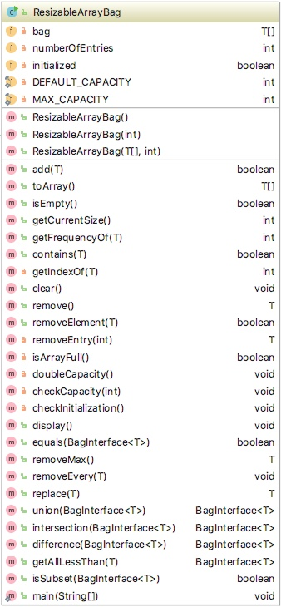
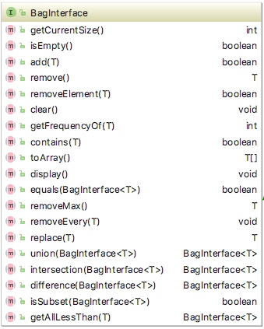
UML diagram for ResizableArrayBag
UML diagram for the interface Bag

Slide 54
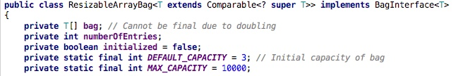
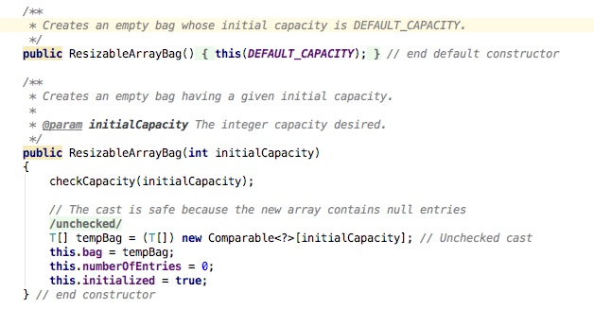
Class ResizableArrayBag – modified to support comparing elements

Slide 55
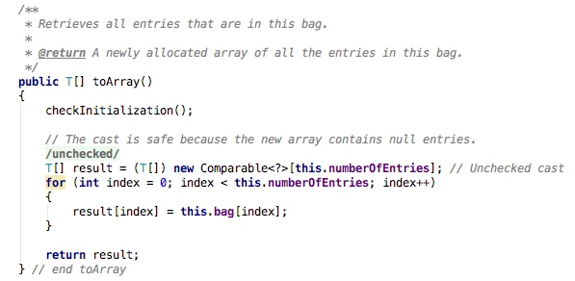
Method toArray – modified to support comparing elements

Slide 56
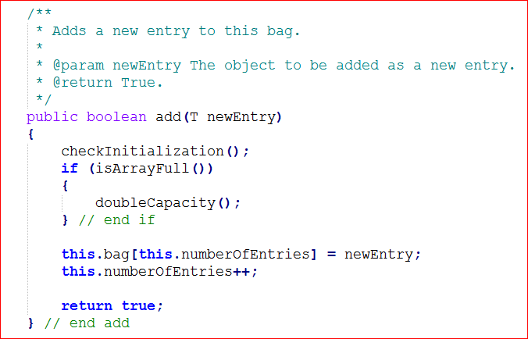
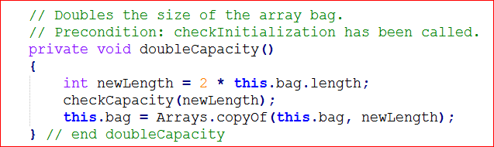
A New Implementation of a Bag
New add
method
  Assumes private method doubleCapacity

Slide 57
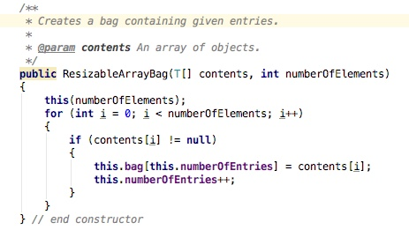
Question
Define a constructor that you could add to the class to initialize the bag to the contents of a given array:
  String[] inputData = {"A", "B", "C", "D", "A", "C", "B"};
  BagInterface<String> bag1 = new ResizableArrayBag<>(inputData, 5);
Is it necessary to copy entries from the argument array to the array bag, or would a simple assignment: this.bag=contents; be sufficient?

Slide 58

Question
What is an advantage of using an array to organize data? What is a disadvantage?
  adding an entry to the bag is fast
  removing an unspecified entry is fast
  removing a particular entry requires time to locate the entry
  increasing the size of the array requires time to copy the entries
  may have unused entries

